Slide 1
Tourmate
Problem: Traveling to a new city can be overwhelming – from finding authentic experiences to avoiding tourist traps.
Solution: Tourmate is a smart mobile app designed to guide foreign travelers through unfamiliar cities with ease.
Features:
Real-time city navigation tailored for tourists
Curated recommendations for dining, museums, landmarks & hidden gems
Localized tips & cultural insights to enhance travel experiences
Value Proposition: Enjoy every trip with confidence, just like a local would.

Slide 2
Tourmate Pro
Free Version:
Smart itinerary planner
Interactive maps & recommendations
Community reviews and local experiences
Paid Version (Tourmate Pro):
Access to local travel experts for personalized guidance
Priority support & exclusive content
Advanced travel customization
Business Model: Freemium app with scalable expert consultation as a premium feature.

Slide 3
Process to Acquire a Paying Customer
Determine Need & Catalyst to Action
Realizes need for better travel planning / unique experiences due to time constraints or lack of quality content
Find Out about Options
Searches Reddit, forums, influencers, or friends for alternatives
Analyze Options
Searches Reddit, forums, influencers, or friends for alternatives
Acquire Your Product
Compares features, value, and price of your platform vs. competitors
Pay
Signs up for a free trial or basic package
Install
Downloads app (if mobile) or begins using the web interface
Use & Get Value
Uses platform to plan trip, books experiences or lodging
Determine Value
Reflects on how useful it was compared to cost/time saved
Buy More
Upgrades, adds more services (like group trips or premium concierge)
Tell Others
Leaves reviews, refers friends, shares on social media

Slide 4
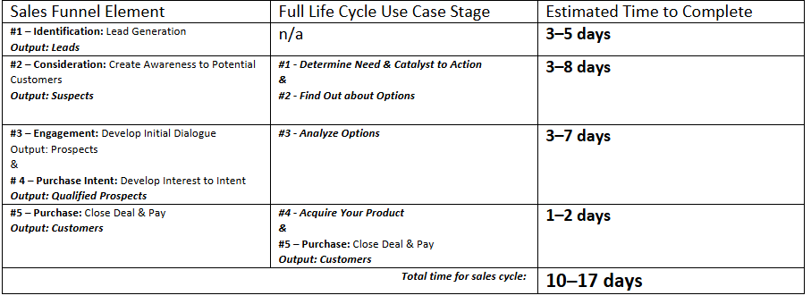
Sales Cycle Length Estimate

Slide 5
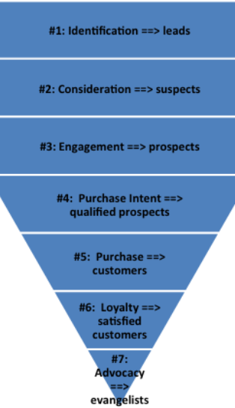
First Draft Sales Funnel Worksheet
#1: Action Plan for Identification:
Leverage SEO-optimized travel blog content, social media (Instagram, TikTok, Reddit), and targeted ads to attract niche travel enthusiasts.
Engage in online communities and watering holes like travel subreddits and Facebook groups.
#2: Action Plan for Consideration:
Deploy email drip campaigns, comparison content (why us vs. others), and influencer testimonials.
Highlight pain points (wasted planning time, uncertainty) and how your platform solves them.
#3: Action Plan for Engagement:
Offer free trials or a limited preview of curated travel plans.
Host webinars or live Q&A sessions to build trust and answer questions directly.
#4: Action Plan for Purchase Intent:
Provide clear pricing, a frictionless sign-up flow, and urgent offers (discounts, limited spots).
Use behavioral triggers like “you left something in your cart” to nudge signups.
#5: Action Plan for Purchase:
Offer easy checkout and a welcome experience that confirms their decision.
Use a friendly onboarding walkthrough to ensure immediate perceived value.
#6: Action Plan for Loyalty:
Provide personalized trip suggestions, loyalty rewards, and early access to premium features.
Keep in touch with tailored emails based on past behavior or saved preferences.
#7: Action Plan for Advocacy:
Launch a referral program and showcase customer stories on social media.
Encourage reviews/testimonials and reward users for sharing your platform publicly.

Slide 6
Windows of Opportunity and Triggers
emotional, spontaneous moment
high intent and openness to inspiration.
highly relatable
has strong peer influence
Primary Window of Opportunity:
Seeing a friend post an amazing trip on Instagram.
Triggers:
Instagram ad or sponsored post
Personalized quiz
Influencer post showing trip highlights and direct link to plan your own
Mobile notification, for existing users, when a similar trip is trending
Retargeted ad

